Slide 2


Slide 3


RSM Cyber | Meeting our clients where they need us most
Assess
Advise
Implement
Manage
SERVICES
Attack Surface Management
Identify and reduce attack surface through continuous proactive management
Vulnerability management
Penetration testing & red teaming
Asset discovery and management
Technical cyber compliance programs
Resilience &�Recovery
� �Understand cyber resilience obligations and prioritize recovery operations
Impact analysis�
Business continuity & disaster recovery
Application & system rationalizations
Third party risk management
Secure Cloud
Embark on your cloud journey in a controlled and secure manner
Cloud posture management
Platform design, development and deployment
Secure operations and administration
Cloud infrastructure entitlements management
Architecture &�Engineering
� ��
Manage the risks of todays boundary-less environment
IoT and operational technologies
Industrial control systems
Zero-trust and enterprise architecture
Standards and runbooks
Cyber solution engineering
Security tools & technologies
Application�
Security
��
Drive secure practices throughout the application development lifecycle
SecDevOps
Secure code analysis
Web app security testing
Secure design principles
Data classification & protection
Continuous penetration test
Detect & Respond
Effectively and efficiently identify and quickly respond to incidents
RSM DefenseTM  managed security
Security operations�
Threat intelligence
Digital forensics & incident response
Endpoint detection & response
Strategy & Risk
Design and implement transformative cyber programs
Maturity and risk assessments
Policies and procedures
Program design and management
Framework design
Virtual CISO
Security awareness training
Cyber workforce development
Compliance &�Governance
Decipher framework, regulations and standards compliance
Assurance, accreditation, and certification (i.e., PCI, FedRamp, CMMC, HiTrust, etc.)
Third-party risk
Governance, risk & compliance (GRC)
Privacy
Digital Identity
Securely manage human and device identities across your universe
Governance & administration
Privilege access
Authentication & authorization
Identity threat detection & response
User behavior analytics
Emerging�
Technologies
Making sense of security implications from technology innovations to prioritize resources
Artificial Intelligence
Autonomous vehicles
Metaverse & augmented reality
Virtual power plants (VPP)
Notes:
Daniel

Slide 4



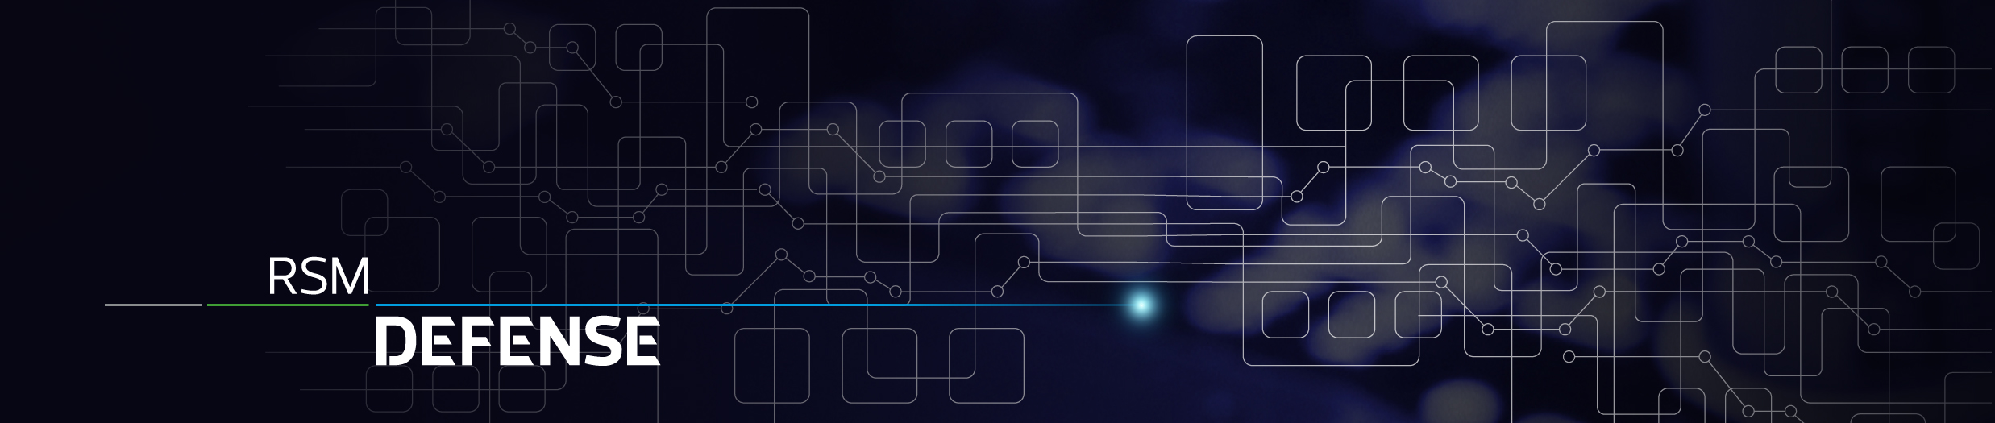






Slide 5




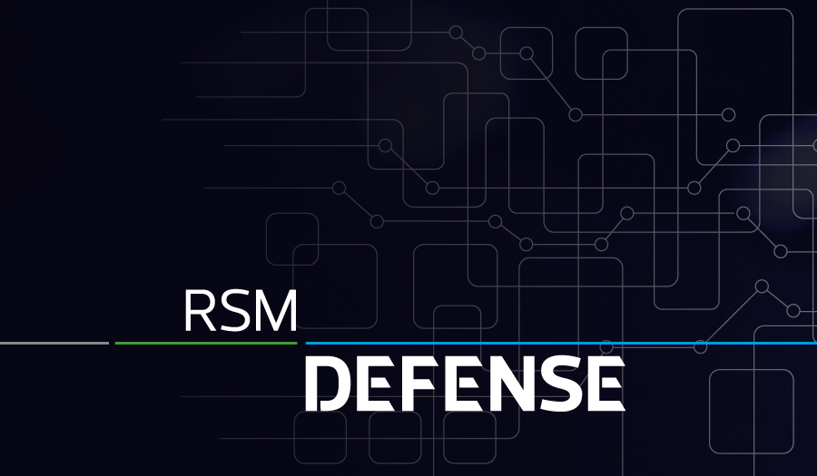




10,000 daily threats detected and blocked
40,000 unique threat indicators
150K+ endpoints and assets managed
75
collective years delivering managed security solutions
250 security professionals
900+ cybersecurity clients nationally
Security professionals in countries
29

Slide 6







Slide 7




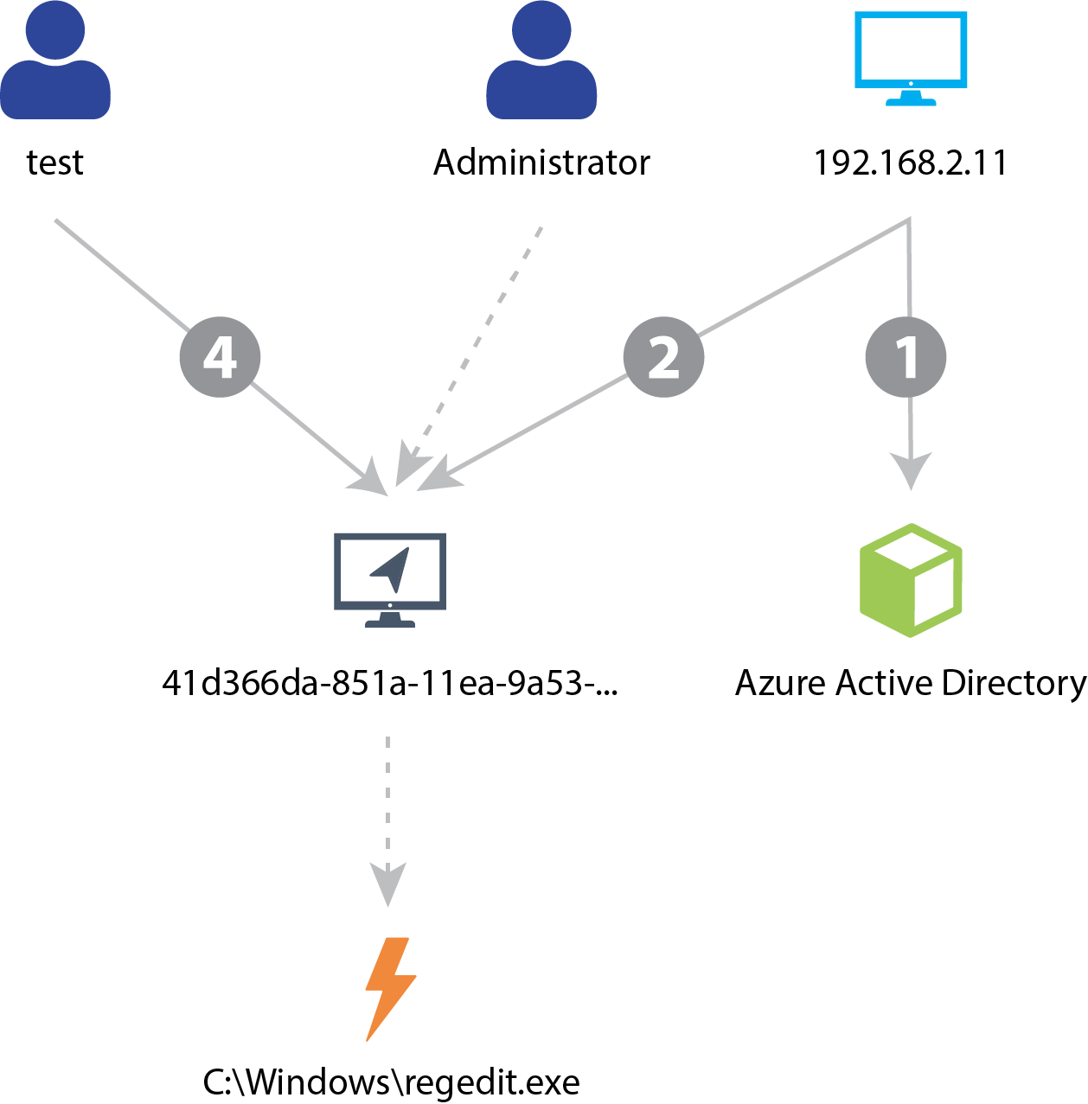




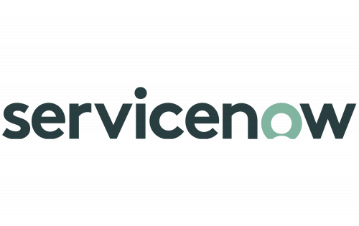
RSM Defense Tech Stack
Entire Enterprise Attack Surface Collection
SENSORS
Normalized, Enriched Data
RSM DEFENSE
Multi Method Detections
ML-Based Incident Correlation
THREAT INTEL
Investigation & Intelligent Response
!
NETWORK
XDR Portal
KNOWN BAD
ENDPOINT
!
YOUR TOOLS
CLOUD
UNKNOWN BAD
IT / Security Service Management
LOCATION
ASSET USER CONTEXT
IDENTITY
APPS

Slide 8




Fully managed NG-XDR service offering
Extended Detection & Response
24x7 Security Operations
Threat Hunting & Tuning
Incident / Case Handling
Mature Documented Procedures
Custom Threat Intelligence Subscriptions
Vulnerability Management
Weekly scanning / Monthly Reporting
Endpoint, Network, Cloud Visibility
Measurable Program Results
Custom Remediation Options
Endpoint Detection & Response
Fully managed EDR or BYO
Signature & Behavior Detection
SOAR Automation  Drop, Disable, Contain
Network Detection & Response
Network Traffic Analyses
Deep Packet Inspection / Blocking
Behavior Analysis / Certificate Inspection
Configuration Monitoring
Privacy Framework
Security Framework
Training & Phishing
KnowBe4 Platform
Fully Customized
Measurable Program Results

Slide 9
XDR Threat Detection Service

Slide 10









XDR Service
Extended Detection & Response (XDR), All-in-One Security Operations services.
Turnkey detection and response service to ingest, enrich, contextualize, hunt, and respond with 100% threat visibility. Block hot and fast attacks. Detect slow burn attacks. Respond with decisive actions 24x7x365.
SIMPLE FIREWALL
DEFENSE IN DEPTH
XDR
MATURITY
Single Platform, Detect, Correlate, & Respond
FIREWALL
IAM
SIEM
ENDPOINTS
Outcomes
THREAT HUNTING
RISE OF CORRELATIONS
ENABLING TECHNOLOGY
CASB
EMAIL SECURITY
Machine Driven Auto Correlations
Improve incident decision support for security operators with prescriptive remediation actions
Reduce Mean Time to Respond and Recover with native and 3rd-party responses
Automate uniform remediation & recovery across the organization
IDS
RISE OF AI
Machine Driven
Detections
Automated
Response
Detect Attacks Across the Attack Surface
RISE OF DATA
Network & Endpoints
Application & Cloud
Siloed Data Lakes
Data Duplication
Single Data Lake
NDR
NG SIEM
Threat Hunting
Playbooks
EDR
Vulnerability
SOAR

Slide 11









Slide 13
Individual Services & Capabilities

Slide 15
Service Matrix
Level of Protection
 | Vulnerability Scanning | Endpoint Detection & Response | RSM Defense Foundations | RSM Defense XDR
24x7x365 SOC |  | � | � | �
Asset Risk Identification | � | � | � | �
Endpoint & Network Vulnerability Scanning | � |  |  | �
Threat Intelligence Enrichment | � | � | � | �
Monthly Industry Focused Threat Intelligence Newsletter |  |  |  | �
Realtime DNS Threat Protection |  |  | �¹ | �¹
Full Function EDR Agent Included |  | � | �² | �²
Email & Identity Protection |  |  | �³ | �
Signature and Behavior Detection |  | � | � | �
Autonomous Response |  | � | � | �
Threat Hunting Automation by Senior Analysts |  |  |  | �
Incident/Case Handling |  | � | � | �
Client Portal Access |  | � | � | �
Access to 24/7/365 SOC Hotline | � | � | � | �
Static Log Collection(Sensor and API Integrations)⁴ |  |  |  | �
RSM Defense Monthly Newsletter | � | � | � | �
¹ RSM defense-provided agent or client-provided
² Eligible for BYOEDR or RSM Defense provided agent
³Domain Controllers will receive a Log Collection sensor in hybrid environments
⁴Log sources (API, syslog, custom) are all ingestion based. Fees may vary on a month-to-month basis

Slide 16

Vulnerability Services
Vulnerability Management(VM), a component of RSM Defense NG-XDR, enables rapid attack vector identification and proactive security. Vulnerability identification and prioritization build resiliency for the continuity of operations. Basic scan and report services or higher touch vulnerability management options are available.
BEHIND EVERY BREACH HEADLINE ARE KNOWN FLAWS
SEE
Exposure
RANSOMWARE IS THE MONETIZATION OF POOR CYBER HYGIENE
#
1
IN COVERAGE, ACCURACY AND ZERO DAY RESEARCH
Outcomes
100% Cloud / Network / Asset Visibility
Proactive cyber risk management
Prioritize risks based on exposure and enable targeted remediation
>350
>67K
<24h
Zero Days disclosed by Tenable Research since January 2019
Vulnerabilities assessed with 167,000+ Plugins
Median coverage time of high-profile issues

Slide 17





Slide 18
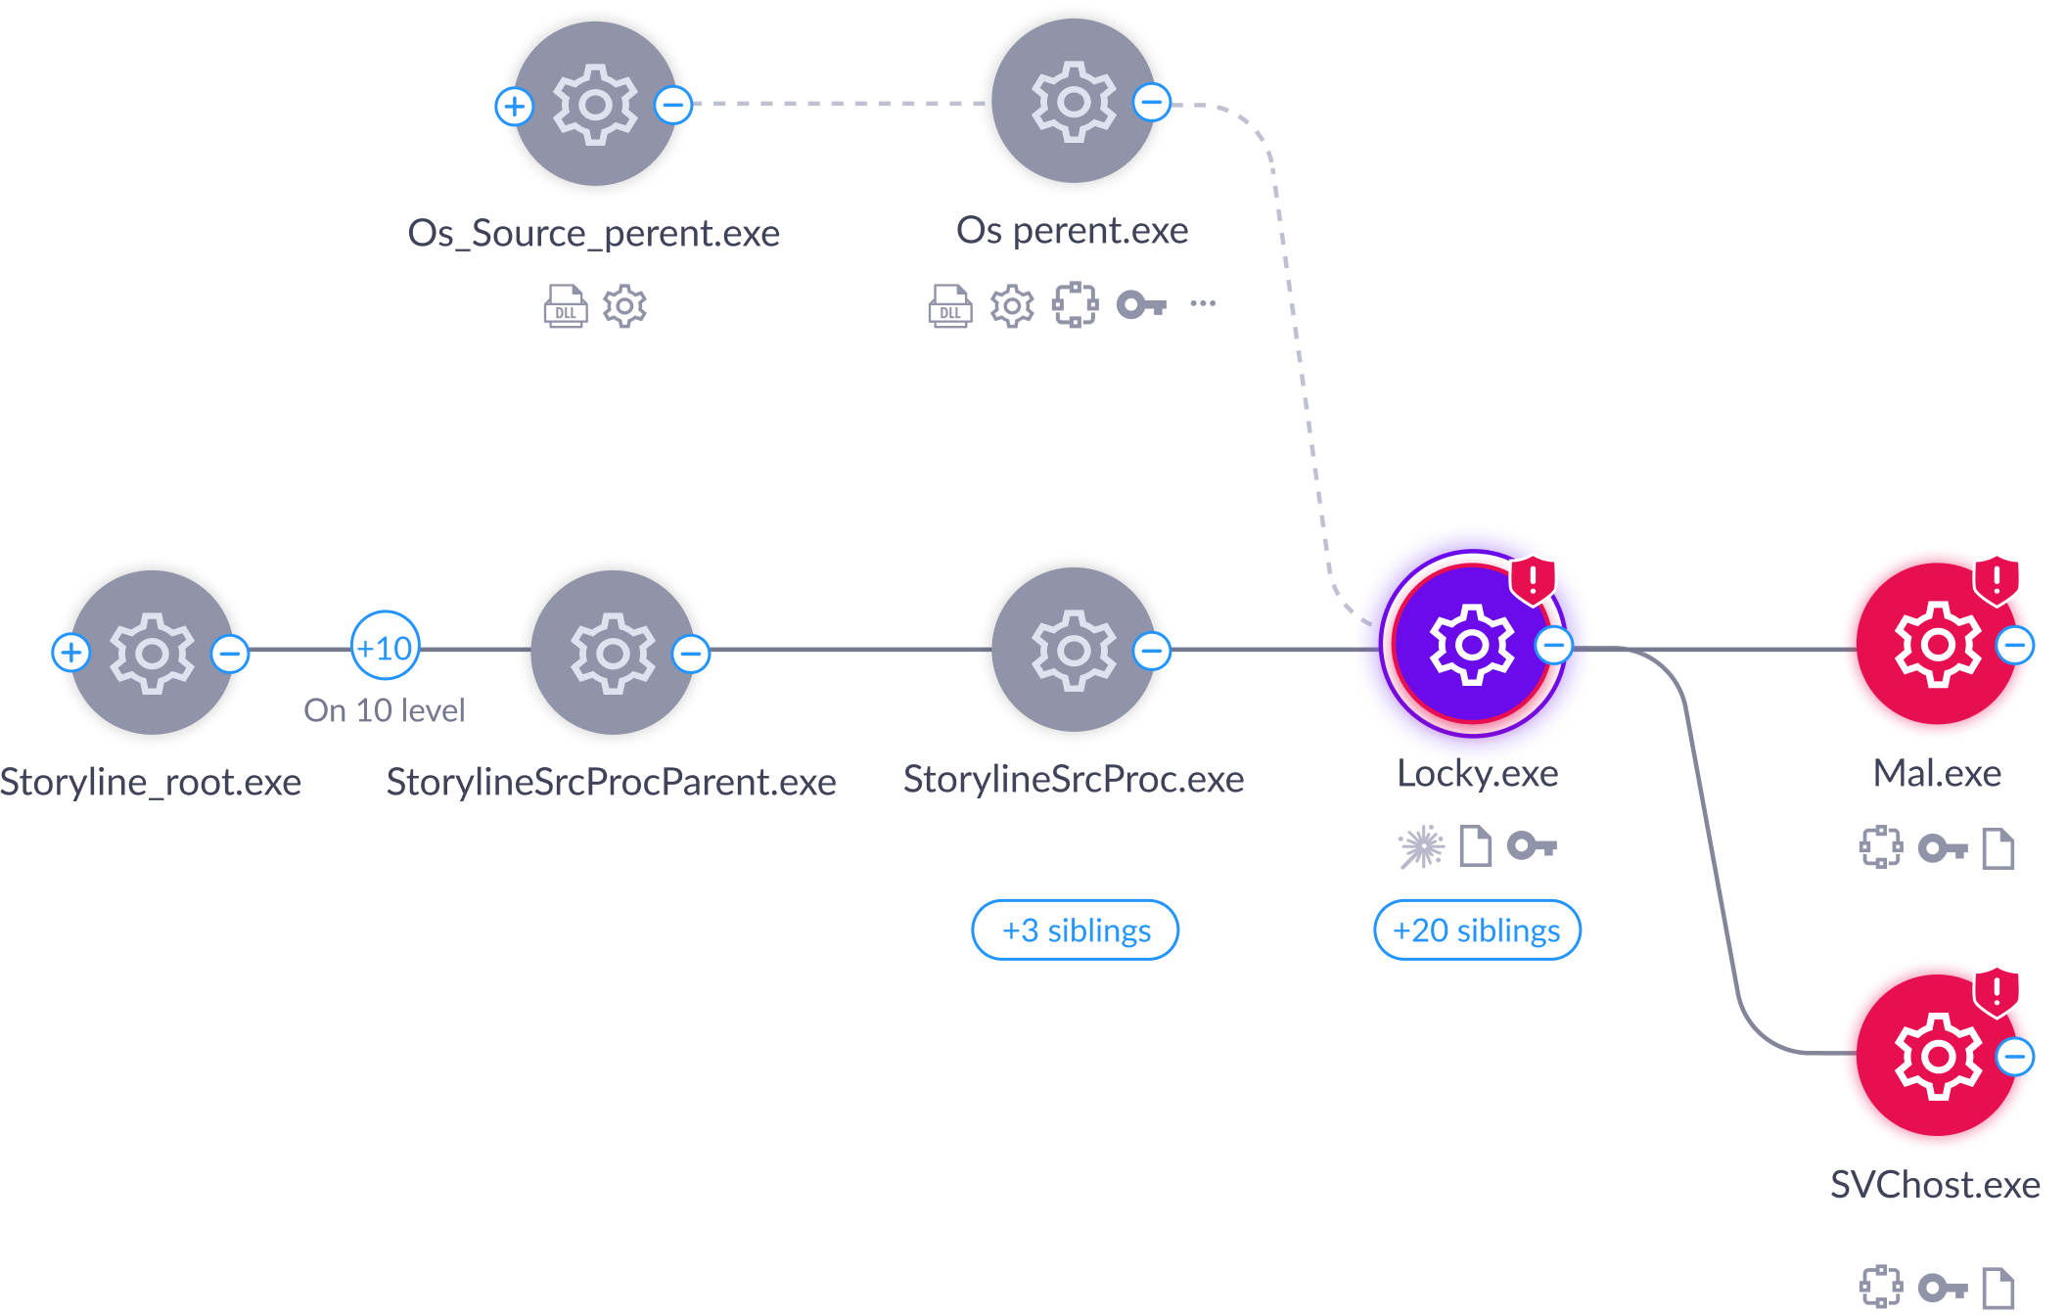








Slide 19
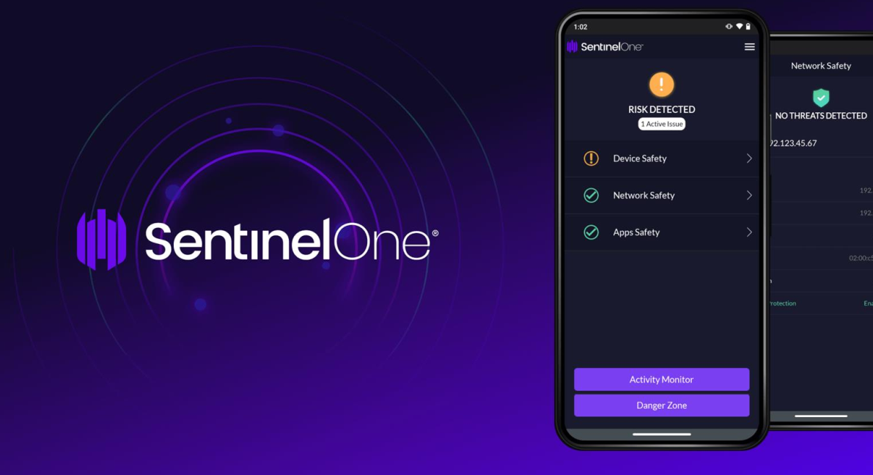

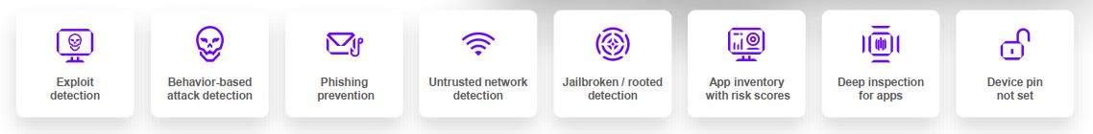
Mobile Threat Defense�
RSM Defense is committed to cover all your attack surfaces, even mobile. Work happens anywhere at anytime and mobile is a critical component of how distributed and modern enterprises verify trust and identities, but mobile devices also access many of the same critical company data and resources that servers and endpoints do.
Easy to Manage
� Supports the major mobile platforms (iOS, Android, Chrome OS)
� Zero touch deployments
� Compatible with leading MDMs. However, MDM optional.
� Easy on batteries.
Autonomous AI Protection & Visibility
� On-device, real time, adaptive behavioral threat protection
� Known & unknown malware, phishing, exploits, MITM protection
� Supports conditional access & orchestrated response
Privacy by Design
� Balances data privacy with security
� BYOD safe. Never collects user (owner) content or messages.
� Can disable collection of app inventory and network details

Slide 20
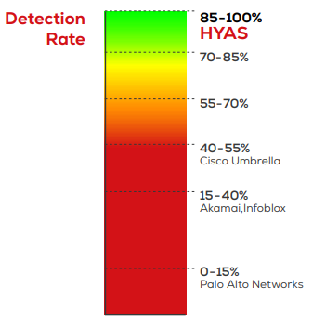
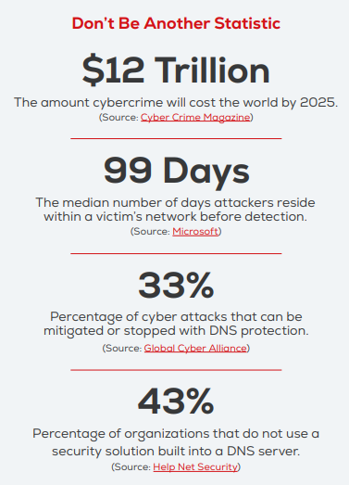

Slide 21
More About RSM Defense

Slide 22






Client realized benefits from RSM Defense platform
Scalability & coverage  24/7/365 security operations, threat intel, and incident response & recovery
Predictability & cost savings - an all-inclusive monthly subscription pricing model
Personalized interaction with an industry focus and deep technical experience  eliminate the hassle of recruiting, managing, and retaining full-time security professionals
Infuse continuous intel into everyday security operations allowing for intelligent automated responses
Improve the visibility and reliability of your incident detection, response, and recovery activities

Slide 23





RSM Defense by the numbers
6000+
Cyberattacks identified and blocked weekly
3 RSM Defense cyber hubs across the globe
180+
Clients on the RSM Defense platform
35+ RSM Defense team members
200+ million
Events processed daily

Slide 24
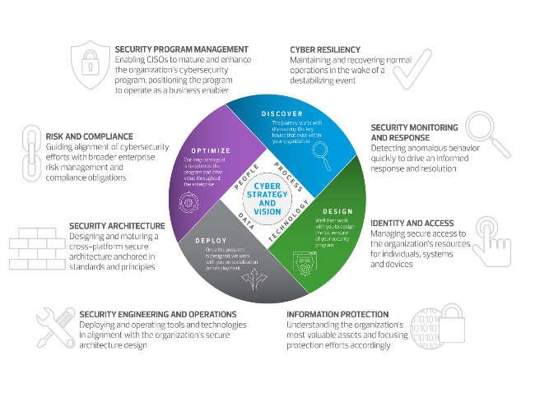
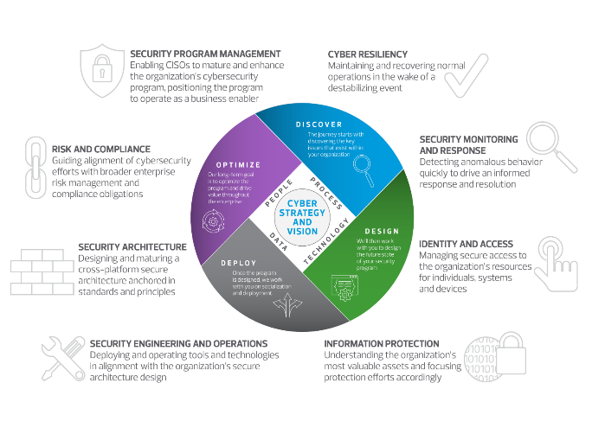
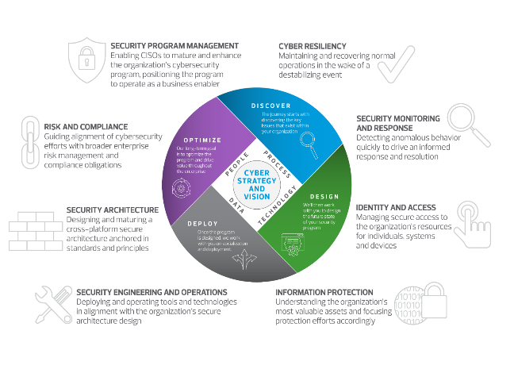






Slide 26

518 Township Line Road, Suite 300
Blue Bell, PA 19422
T 215.641.8600
rsmus.com
RSM US LLP
This document contains general information, may be based on authorities that are subject to change, and is not a substitute for professional advice or services. This document does not constitute audit, tax, consulting, business, financial, investment, legal or other professional advice, and you should consult a qualified professional advisor before taking any action based on the information herein. RSM US LLP, its affiliates and related entities are not responsible for any loss resulting from or relating to reliance on this document by any person. Internal Revenue Service rules require us to inform you that this communication may be deemed a solicitation to provide tax services. This communication is being sent to individuals who have subscribed to receive it or who we believe would have an interest in the topics discussed. RSM US LLP is a limited liability partnership and the U.S. member firm of RSM International, a global network of independent audit, tax and consulting firms. The member firms of RSM International collaborate to provide services to global clients, but are separate and distinct legal entities that cannot obligate each other. Each member firm is responsible only for its own acts and omissions, and not those of any other party. Visit rsmus.com/aboutus for more information regarding RSM US LLP and RSM International.
RSM, the RSM logo and The power of being understood are registered trademarks of RSM International Association, used under license.
� 2024 RSM US LLP. All Rights Reserved.

